Slide 1
Classification and Detection with CNN
CS6476 Computer Vision Fall 2018 - Final Project
Chong Duan
cduan34@gatech.edu

Slide 2
Neural Network Models Implemented
Name | Pre-trained weights | Structure
Model 1: VGG16 | No | Input – VGG16 – Flatten – FC1 – FC2 - Output
Model 2: VGG16 | Yes | Input – VGG16 – Flatten – FC1 – FC2 - Output
Model 3: NN-single-digit | No | Input-Conv1-Pool1-Conv2-Pool2-Dropout-Flatten-FC1-FC2-Output
Model 4: NN-multi-digit | No | Input-Conv1-Conv2-Dropout1-Conv3-Conv4-Dropout2-Conv5-Conv6-Conv7-Flatten-FC1-Dropout3-FC2-ParallelPredLayer-Output

Slide 3
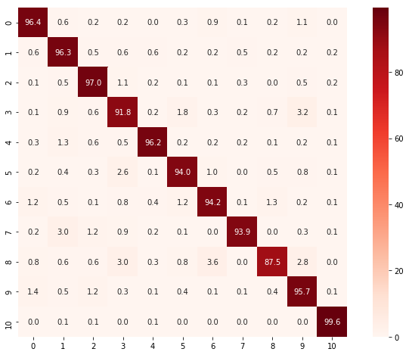
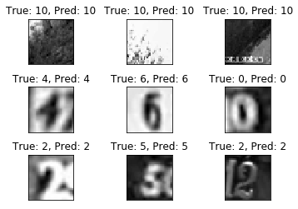
Model 1, 2, and 3 – Detecting and Classifying a single digit
Confusion Matrix of Accuracy
Sample Results

Slide 4
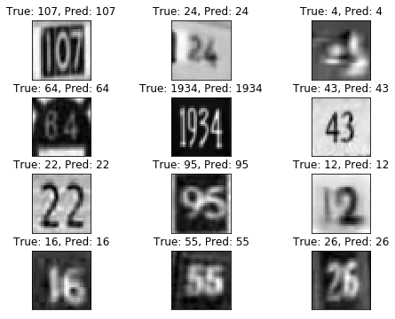
Model 4 – Detecting and Classifying Multi-digit Number in an image
Sample Results
Evaluating Metric
Test accuracy:
1th digit accuracy 89.529 %
2nd digit accuracy 91.383 %
3rd digit accuracy 86.064 %
4th digit accuracy 75.342 %
5th digit accuracy 0.000 %
5th digit accuracy is low as there is almost no sample with 5-digit number in SVHN dataset

Slide 5
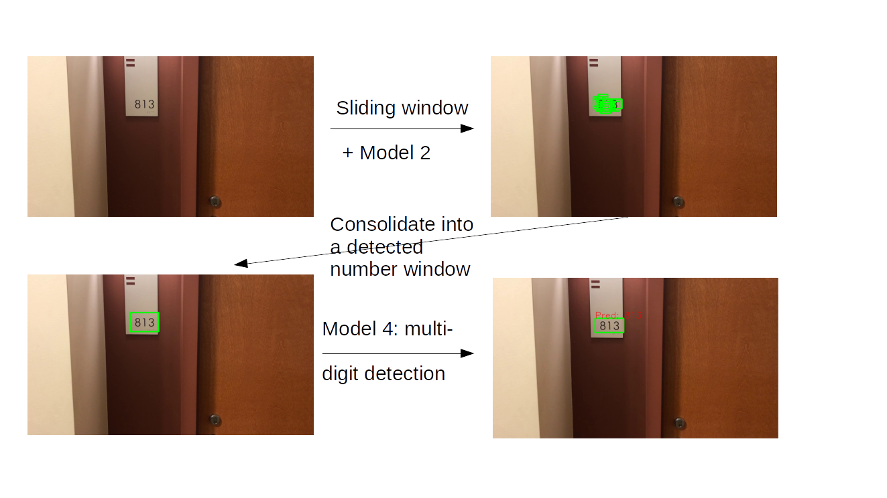
Overall Pipeline

Slide 6
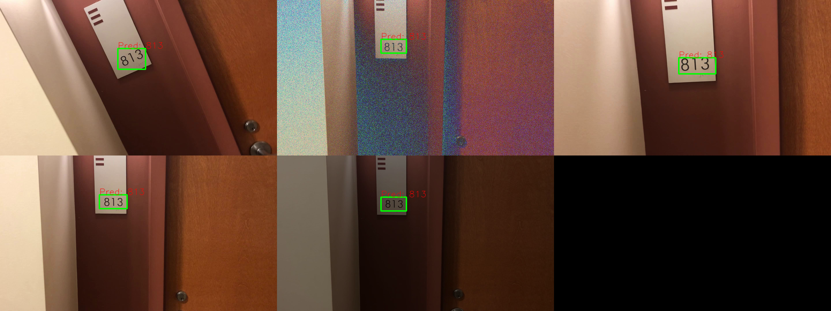
Testing under different conditions
pose (orientation)
noise
scale
original
lighting

Slide 7
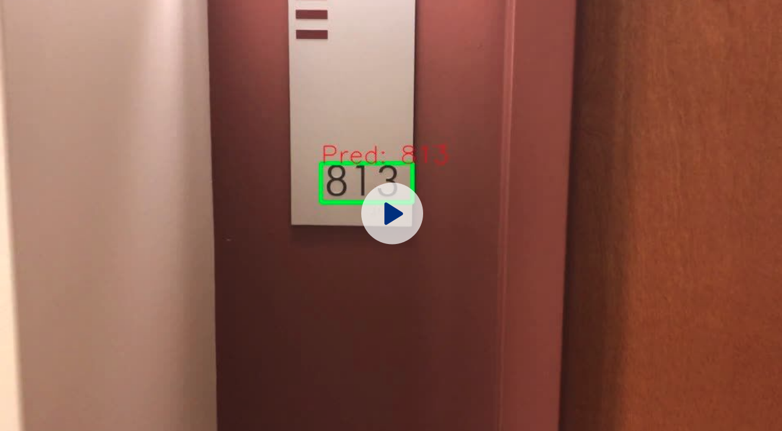
Final processed video
The output video:
https://www.dropbox.com/s/it90v43a3jox1d3/video_out.avi?dl=0

